Slide 1
Kubernetes & microservices an easy way to build scalable solutions Pawel Troka
Or how to scale without losing sanity

Slide 2


About myself
Simulations
C#
Paweł Troka
E-Mail: Pawel@TROKA.Software
LinkedIn: /in/paweltroka/
GitHub: @PawelTroka
Twitter: @PawelTroka
Automation
Algorithmic trading
Math
Python
Science
Numerical calculations
BY DAY: Team Leader at Powel AS
BY NIGHT: I build Computator.NET - a unique, open numerical software that is fast and easy to use
Open APIs
.NET
Smart home
Energy trading
Microsoft
Open source

Slide 3
Scalability
The ability of a service to increase its capacity by consuming more resources

Slide 4
Classical Web development (born ~1996, popular 2002 – today)
Let’s have a look at what we used to do for classical web development

Slide 5
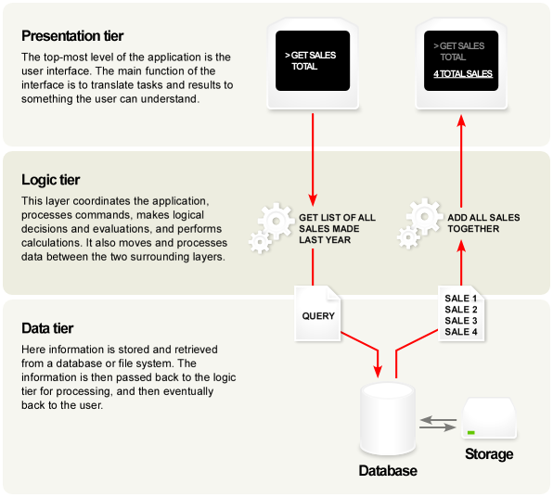
Classic 3-tier architecture

Slide 6
Scaling 3-TIER ARCHITECTURE?
Usually not easy
Logic-tier could be duplicated
makes sense only for CPU-bound problems
state sharing problem might arise
DB tier
normally scaled vertically (adding more RAM, faster CPU, etc.)
scaling horizontally introduces data consistency problems

Slide 7
Cloud based web development (born ~2006, popular 2012 – today)
Evolution of classical web development
Use of managed (cloud-provided) services
Transfer of responsibilities (like hardware, security) to the cloud provider
Notes:
~ is not understandable

Slide 8
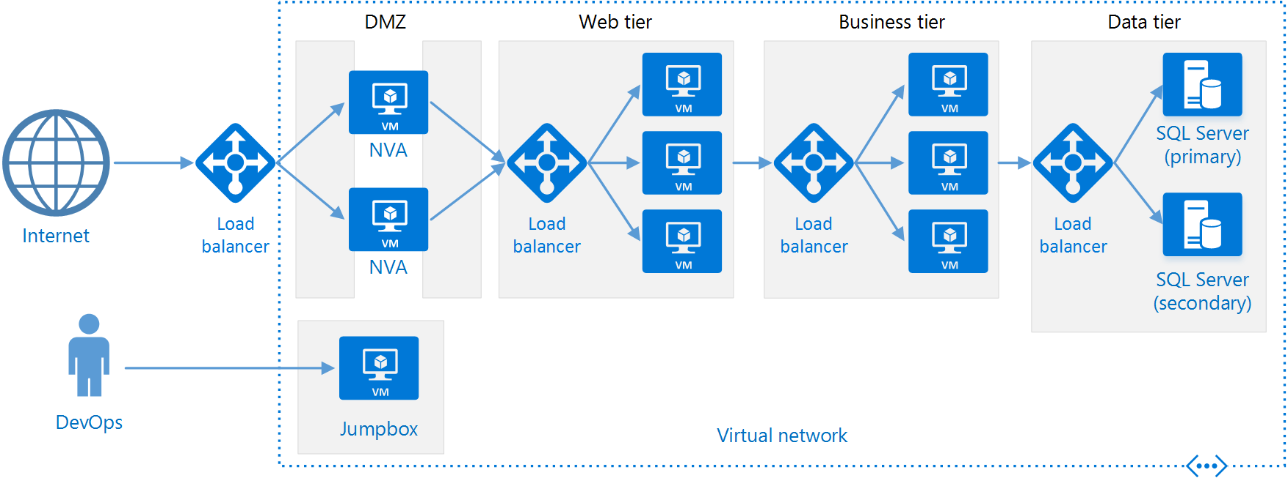
N-TIER ARCHITECTURES

Slide 9
Scaling N-TIER ARCHITECTURE?
Typically database sharding required for scaling, then questions about eventual vs strong consistency
Logic tier scales well for CPU-bound problems but in other cases might depend too much on database scaling
Often vendor-locked – using multiple features of given cloud provider – no possibility or really hard to move to other provider
A lot of manual work in order to make it good
When to do restarts?
How to make updates work?
Do we need to implement health checking / monitoring?

Slide 10
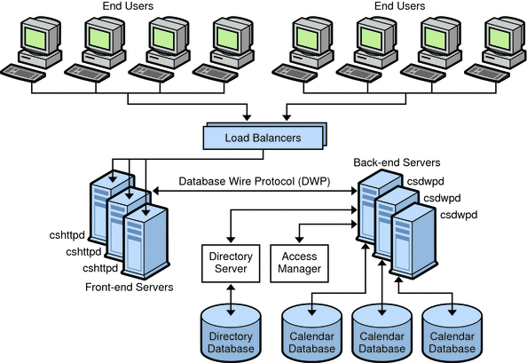
Scaling N-TIER ARCHITECTURE?

Slide 11
Microservices (born ~2012, popular 2014 – today)
Evolution of service-oriented architecture (SOA)
In simple words: instead of diving application into physical / logical tiers, let’s divide it into smaller applications
Well defined responsibilities, loose coupling, great testability (think SOLID in terms of software architecture)

Slide 12
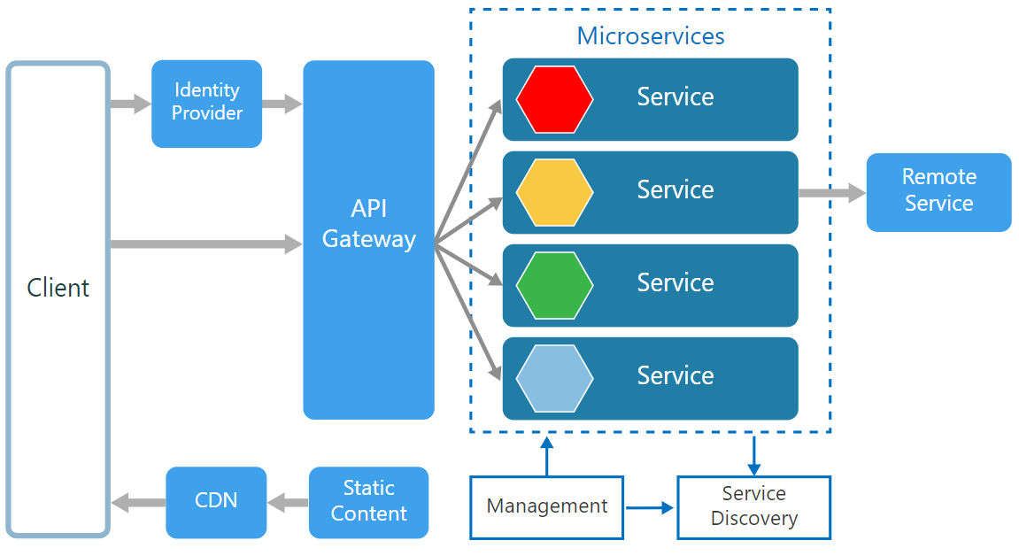
Microservices / Service oriented architecture

Slide 13
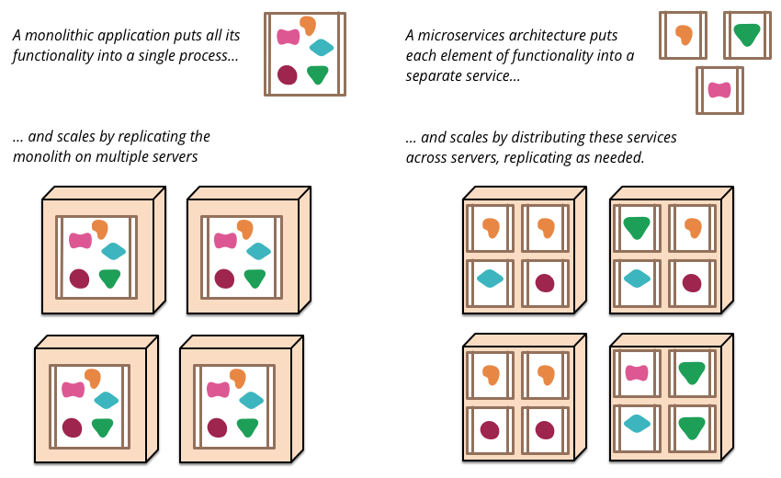
Scaling microservices?
A monolithic application puts all its functionality into a single process…
… and scales by replicating the monolith on multiple servers
Monolithic (N-Tire application)

Slide 14
Scaling microservices?
A monolithic application puts all its functionality into a single process…
… and scales by replicating the monolith on multiple servers
A microservices architecture puts each element of functionality into a separate service…
… and scales by distributing these services across servers, replicating as needed.
Monolithic (N-Tire application)
Microservice

Slide 15
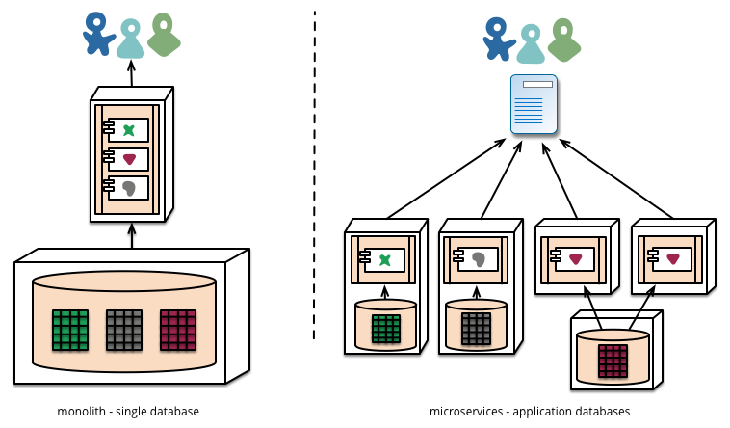
Comparing architecture
N-Tire architecture
Microservice

Slide 16
Problems with microservices?
Complexity
Operational issues (Monitoring, logging, …)
Maintainability issues (cause of defect, …)
Harder development and testing (More components, …)
Network congestion (More communication)
Environment cluttering
Versioning
…
Notes:
Network congestion is the reduced quality of service that occurs when a network node or link is carrying more data than it can handle. Typical effects include packet loss or the blocking of new connections.

Slide 17
Problems with microservices?
Environment cluttering?
Do I need Node.js v8.11.0 or is v6.12.1 good enough?
Does “ServiceA” use Python3 or Python2, because “ServiceX” is only working with Python3? Do I need both on the same VM?
“ServiceXYZ” was only tested on Ubuntu 14.04 with .NET Core 1.0.11 but a new service “BCX12” was developed on Ubuntu 18.04 with .NET Core 2.1.200. Can we have them both on a shared VM? We already have soooo many VMs…
Why isn’t it working on “that machine”? Is incorrect npm version to blame?
Notes:
Cluttering is not a really good word here
https://en.wikipedia.org/wiki/Polyglot_(computing)

Slide 18
Solution?

Slide 19
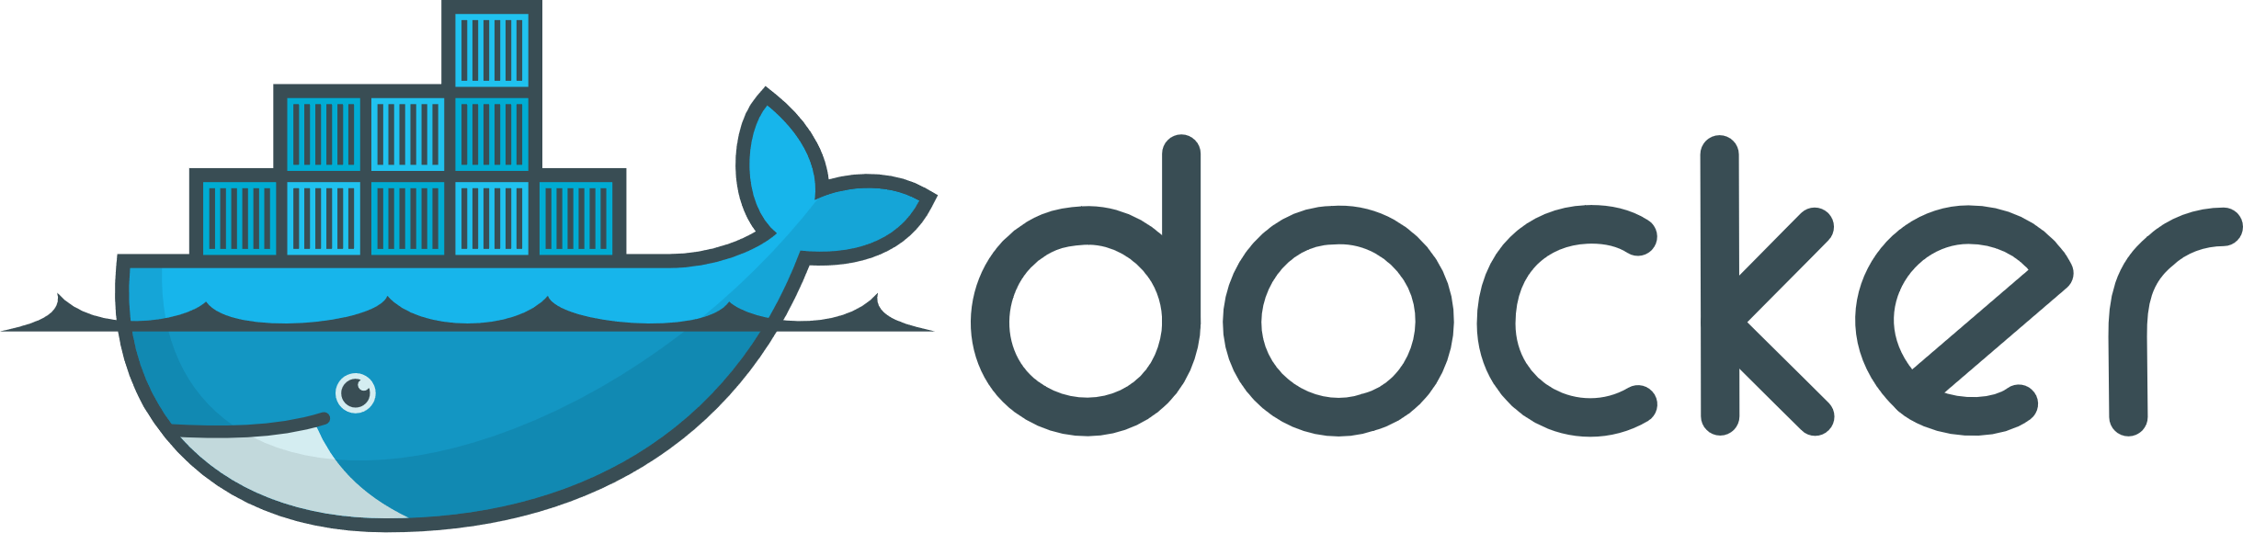
Enter containerized world!
Docker containers are a way to tangle environment cluttering, constant configuration problems, versions of 3rd party components
Notes:
…Docker the leading software container solution on the market

Slide 20
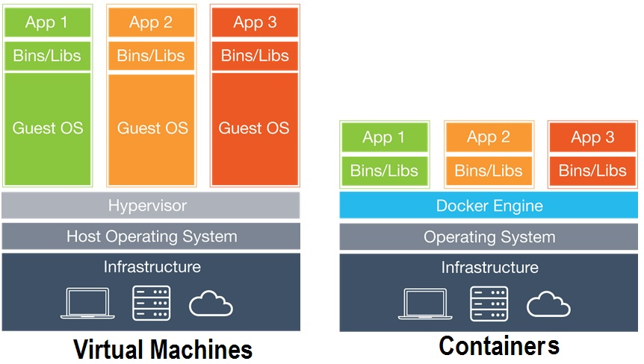
What are Containers?
Container is an optimized alternative to a Virtual Machine
Virtual Machine virtualize the hardware using a Guest OS (Operative System)

Slide 21
What are Containers?
Container is an optimized alternative to a Virtual Machine
Virtual Machine virtualize the hardware using a Guest OS (Operative System)
Containers operate on top of a shared operating system
⇒
Can run 4x to 6x the number of containers as you could VMs
Containers can initiate in milliseconds versus minutes for VMs.

Slide 22
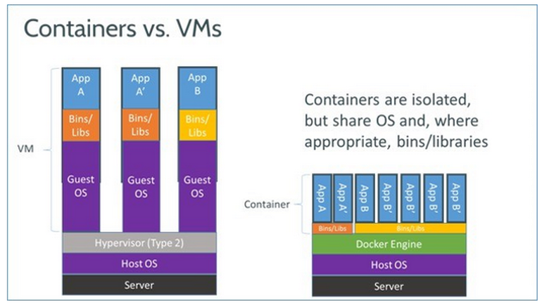
What is Docker?
A computer program that performs operating-system-level virtualization also known as containerization
Think of it as a lightweight virtual machine, which can additionally share a great deal of resources between containers (images/machines)
Instead of having 10 services x 10 GB VMs = 100 GB you have 10 GB machine that has 10 services, each in a container on top of this machine and each adds let’s say 200 MB => 12 GB

Slide 23
Containers
So each service lives in its own container – we defeated environment cluttering, configuration issues, and we didn’t need to have a 1 TB rig to host a bunch of VMs ☺
Basically we made having a polyglot systems solutions (which micro-services often are) a lot easier
However we still didn’t tackle
operational and maintainability issues and
we haven’t had a basic look at scaling the services yet?
What if we have 100+ micro-services? How to manage that?

Slide 24
A way to make scaling great?
Microservices are a great way to scale but a pain to manage
Kubernetes is the answer.
Notes:
From this page and onwards -> Pawel

Slide 25
Kubernetes
Kubernetes has a number of features. It can be thought of as:
a container platform
a microservices platform
a portable cloud platform and a lot more.
Kubernetes provides a container-centric management environment. It orchestrates computing, networking, and storage infrastructure on behalf of user workloads. This provides much of the simplicity of Platform as a Service (PaaS) with the flexibility of Infrastructure as a Service (IaaS), and enables portability across infrastructure providers

Slide 26
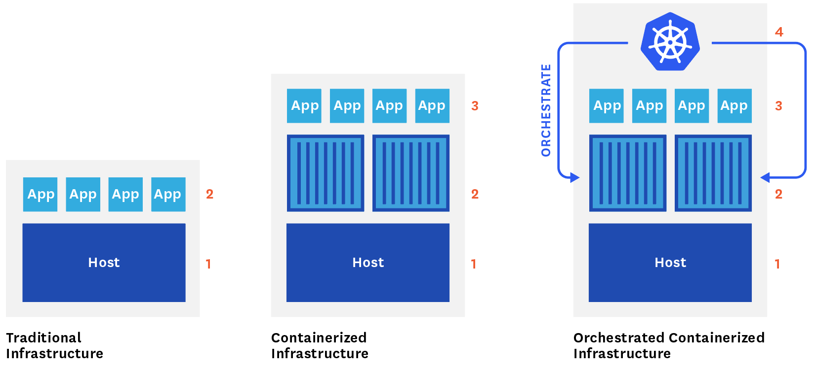
Kubernetes

Slide 27
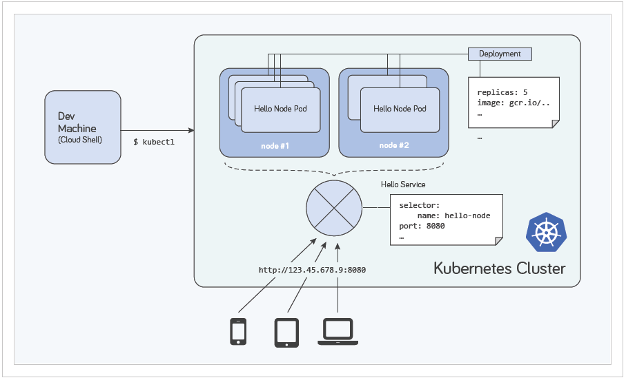
Kubernetes architecture
Add here something about K8s architecture (deployments, namespaces, pods, replicas, etc)

Slide 28
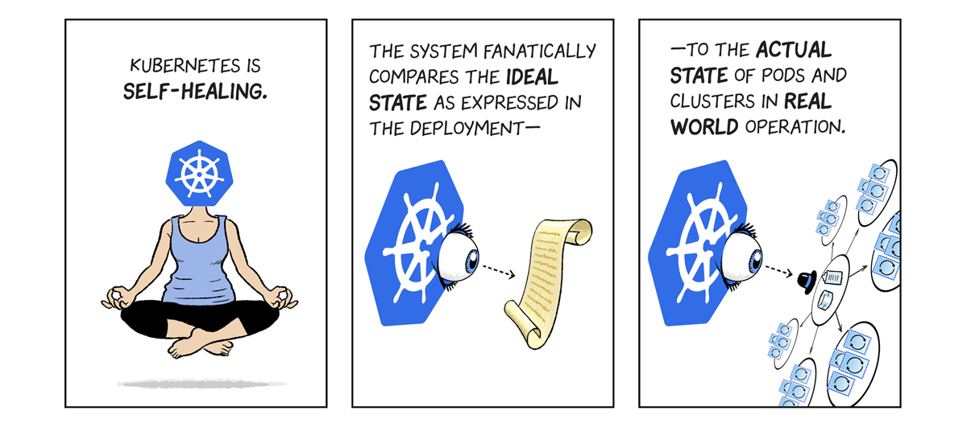
Kubernetes
Declarative way
Everything in K8s can be defined using yaml file
apiVersion: apps/v1
kind: Deployment
metadata:
name: nginx-deployment
labels:
app: nginx
spec:
replicas: 3
selector:
matchLabels:
app: nginx
template:
metadata:
labels:
app: nginx
spec:
containers:
- name: nginx
image: nginx:1.7.9
ports:
- containerPort: 80

Slide 29
Kubernetes scaling
In simplest words scaling in k8s world is basically done by running multiple instances of your app/service
More specifically it is accomplished by changing the number of replicas in a Deployment

Slide 30
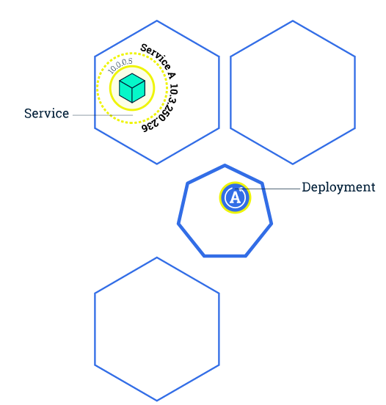
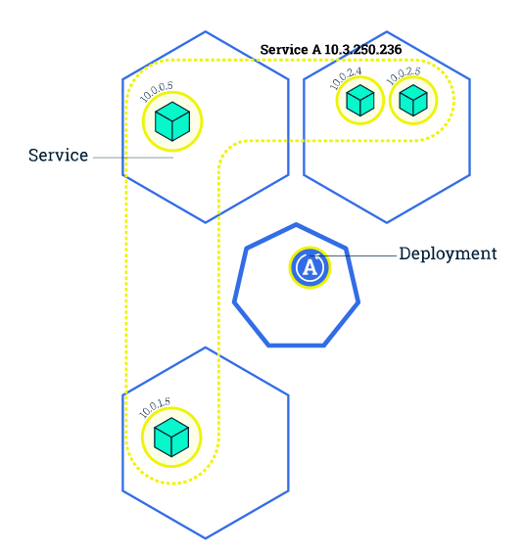
Kubernetes scaling
Scaling is accomplished by changing the number of replicas in a Deployment.
Notes:
Ilustrations are good. We should quite easily described what is going on.
Scaling out a Deployment will ensure new Pods are created and scheduled to Nodes with available resources. Scaling in will reduce the number of Pods to the new desired state. Kubernetes also supports autoscaling of Pods, but it is outside of the scope of this tutorial. Scaling to zero is also possible, and it will terminate all Pods of the specified Deployment.
Running multiple instances of an application will require a way to distribute the traffic to all of them. Services have an integrated load-balancer that will distribute network traffic to all Pods of an exposed Deployment. Services will monitor continuously the running Pods using endpoints, to ensure the traffic is sent only to available Pods.
Scaling is accomplished by changing the number of replicas in a Deployment.
Once you have multiple instances of an Application running, you would be able to do Rolling updates without downtime. We'll cover that in the next module. Now, let's go to the online terminal and scale our application.

Slide 31
Kubernetes scaling
You get for free:
Zero downtime rolling-updates of your app/service
Load balancing (integrated in Kubernetes services) with a possibility to integrate with cloud provider’s load balancing
Continuous monitoring of pods/replicas, health status check, restarts
Traffic isolation, memory limits, etc

Slide 32
Kubernetes AUTO-scaling
Introducing Horizontal Pod Autoscaler
The Horizontal Pod Autoscaler automatically scales the number of pods in a replication controller, deployment or replica set based on observed CPU utilization (or, with custom metrics support, on some other application-provided metrics).

Slide 33
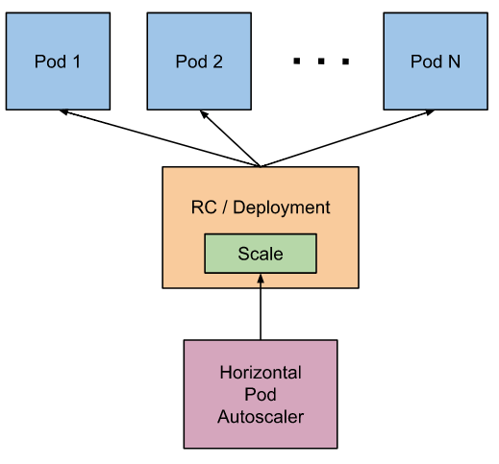
Kubernetes AUTO-scaling
Notes:
The Horizontal Pod Autoscaler is implemented as a control loop, with a period controlled by the controller manager’s --horizontal-pod-autoscaler-sync-period flag (with a default value of 30 seconds).
During each period, the controller manager queries the resource utilization against the metrics specified in each HorizontalPodAutoscaler definition. The controller manager obtains the metrics from either the resource metrics API (for per-pod resource metrics), or the custom metrics API (for all other metrics).
For per-pod resource metrics (like CPU), the controller fetches the metrics from the resource metrics API for each pod targeted by the HorizontalPodAutoscaler. Then, if a target utilization value is set, the controller calculates the utilization value as a percentage of the equivalent resource request on the containers in each pod. If a target raw value is set, the raw metric values are used directly. The controller then takes the mean of the utilization or the raw value (depending on the type of target specified) across all targeted pods, and produces a ratio used to scale the number of desired replicas.
Please note that if some of the pod’s containers do not have the relevant resource request set, CPU utilization for the pod will not be defined and the autoscaler will not take any action for that metric. See the autoscaling algorithm design document for further details about how the autoscaling algorithm works.
For per-pod custom metrics, the controller functions similarly to per-pod resource metrics, except that it works with raw values, not utilization values.
For object metrics, a single metric is fetched (which describes the object in question), and compared to the target value, to produce a ratio as above.
The HorizontalPodAutoscaler controller can fetch metrics in two different ways: direct Heapster access, and REST client access.
When using direct Heapster access, the HorizontalPodAutoscaler queries Heapster directly through the API server’s service proxy subresource. Heapster needs to be deployed on the cluster and running in the kube-system namespace.
See Support for custom metrics for more details on REST client access.
The autoscaler accesses corresponding replication controller, deployment or replica set by scale sub-resource. Scale is an interface that allows you to dynamically set the number of replicas and examine each of their current states. More details on scale sub-resource can be found here.

Slide 34
Kubernetes AUTO-scaling
{{- if .Values.autoscaling.enabled }}
apiVersion: autoscaling/v2beta1
kind: HorizontalPodAutoscaler
metadata:
labels:
app: historical-data
historical-service: "true"
helm-app: {{ .Release.Name | quote }}
name: YOUR_SERVICE_NAME
spec:
scaleTargetRef:
{{- if (semverCompare "<1.9" (printf "%s.%s" .Capabilities.KubeVersion.Major .Capabilities.KubeVersion.Minor)) }}
apiVersion: apps/v1beta1
{{- else }}
apiVersion: apps/v1
{{- end }}
kind: Deployment
name: algo-historical-data
minReplicas: 1
maxReplicas: 3
metrics:
- type: Resource
resource:
name: cpu
targetAverageUtilization: 50
{{- end }}
Notes:
How to scale number of nodes?
Maybe something about managed container service? Why we do not use it?

Slide 35
Summary
Do you want to scale? Go microservices. You can also cut existing applications into more service-oriented architecture. At least don’t settle for using only one, big monolithic database.
Do you want manageable microservices architecture without the headache? Go Kubernetes, it’s already starting to become “de facto” industry standard
Don’t reinvent the wheel ☺ Kubernetes probably already has your functionality covered (multiple extensions available).
Notes:
More of our project into it.
Expose some performance metrics / measurements from Prometheus.
Agile / lean startup model.
The way we are going that -> more agile, code – then see.
Automated performance test for crucial operations (placing order).
Show the audience about possibilities – live performance, get some alarms, use Prometheus. Automatically scale based on Prom metrics.

Slide 36
QUESTIONS?

Slide 37
Thank you!
KEEP IN TOUCH!
Pawel.Troka@powel.com

Slide 38
References
https://kubernetes.io/docs/tutorials/kubernetes-basics/scale-intro/
https://kubernetes.io/docs/tasks/run-application/horizontal-pod-autoscale/
https://stackoverflow.com/questions/312187/what-is-n-tier-architecture
https://stackoverflow.com/questions/11707879/difference-between-scaling-horizontally-and-vertically-for-databases
https://stackoverflow.com/questions/5676718/scaling-mvc-vs-scaling-multi-tier-applications
https://docs.microsoft.com/en-us/azure/architecture/guide/architecture-styles/n-tier
https://docs.microsoft.com/en-us/azure/architecture/guide/architecture-styles/microservices
https://en.wikipedia.org/wiki/Model–view–controller
https://www.computerweekly.com/feature/A-history-of-cloud-computing
https://docs.microsoft.com/en-us/azure/architecture/guide/architecture-styles/
https://martinfowler.com/articles/microservices.html
https://kubernetes.io/docs/concepts/overview/what-is-kubernetes/
https://kubernetes.io/docs/concepts/workloads/controllers/deployment
https://kubernetes.io/docs/concepts/workloads/controllers/deployment/#pod-template
https://kubernetes.io/docs/reference/generated/kubectl/kubectl-commands#rolling-update
https://www.zdnet.com/article/what-is-docker-and-why-is-it-so-darn-popular/
https://en.wikipedia.org/wiki/Docker_(software)
https://www.datadoghq.com/blog/monitoring-kubernetes-era/
https://cloud.google.com/kubernetes-engine/kubernetes-comic/
https://en.wikipedia.org/wiki/Kubernetes

